Slide 1
Scientific writing
Improvement of sport by dint of biomimicry
LEFAY Paul - CESBRON Theo - HERVE Alexis - GELINEAU Emmanuel - GUYON Soren

Slide 2
Summary:
Introduction
Methods
Results
Discussion
Conclusion

Slide 3
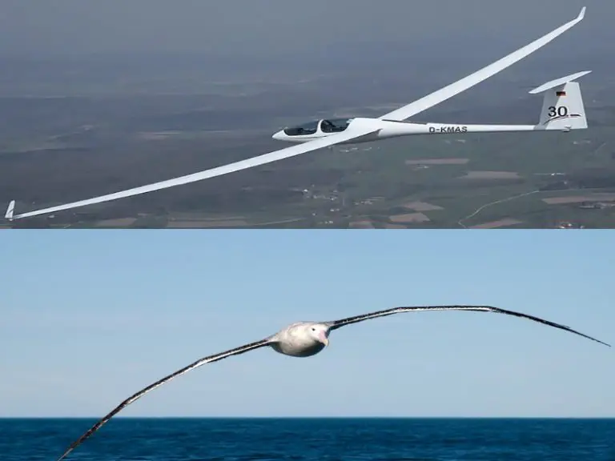
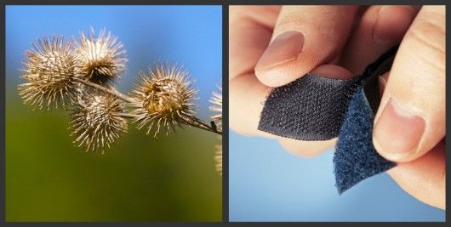
1. Introduction
Wildlife inspire innovations

Slide 4
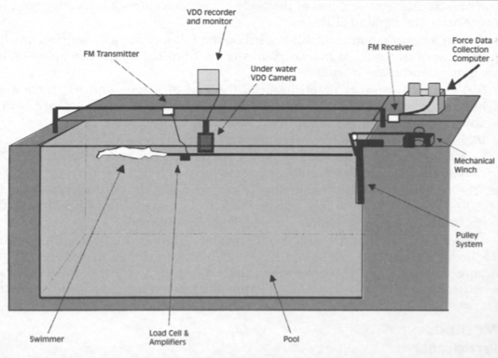
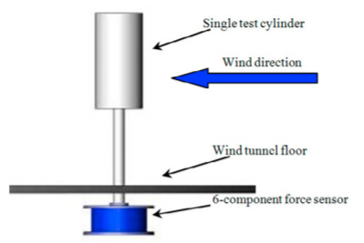
2. Method
Swimsuit experience

Slide 5
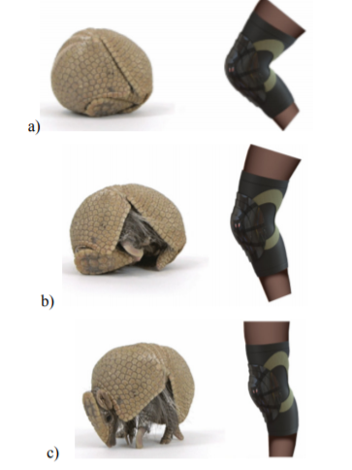
2. Method
Knee protector experience
Impact protection
Mobility
Comfort
Air flow
Fitting Price
Figure: Different protection positions

Slide 6
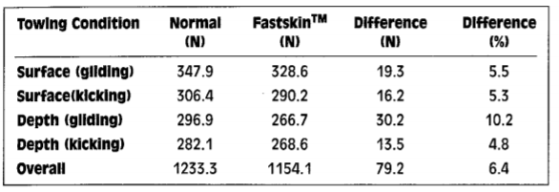
3. Results
Swimsuits comparison
Figure: Drag forces summed over the three towing velocities

Slide 7
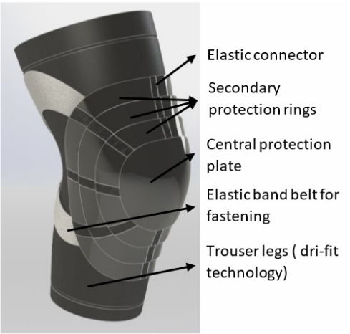
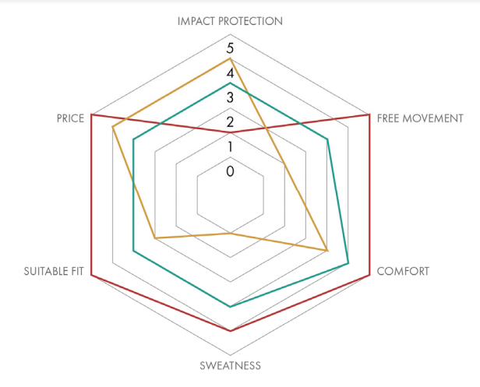
3. Results

Slide 8
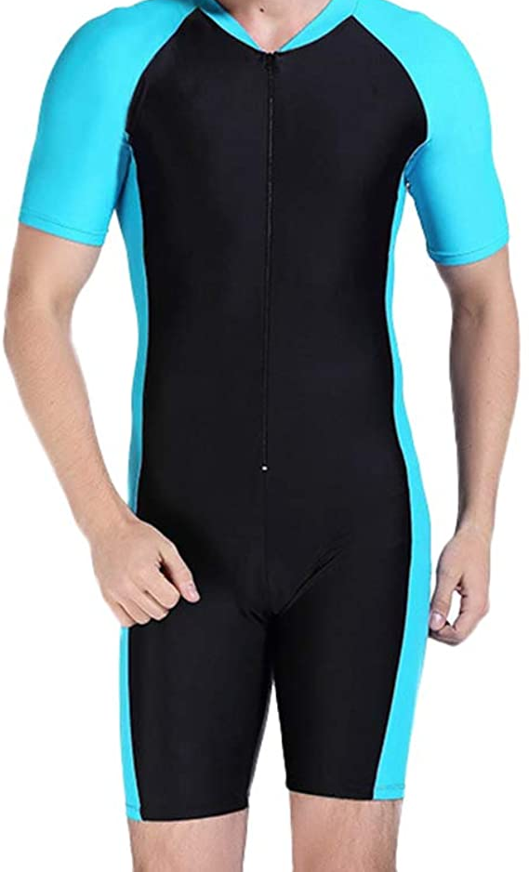
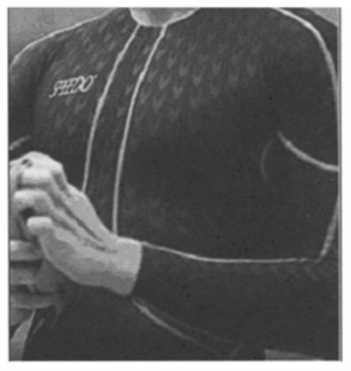
4. Discussion
The fastskin
The armadillo protectors
Improvements

Slide 9
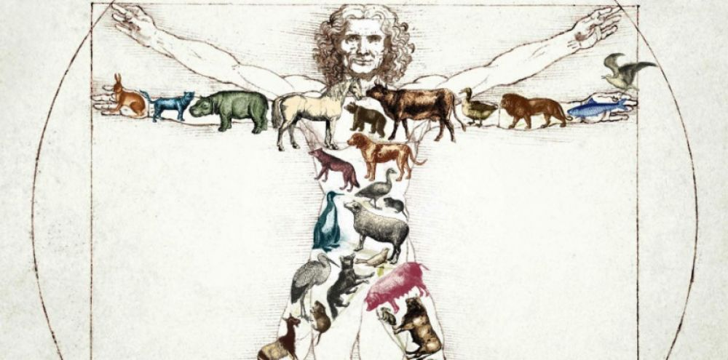
5. Conclusion

Slide 10
Thank you for your attention !

